Slide 1

Flaire
by invisaWear Technologies
Rajia Abdelaziz, Madhu Prakash, Jeremy Daigneau & Alex Chen
Notes:
Rajia: Short Intro, What is invisaWear Technologies

Slide 2
Purpose of Our Project
invisaWearTechnologies.com will allow users to:
Learn about the company’s product: Flaire
View product inventory
Purchase a product, and
Create an account on the website to configure their device's settings
Notes:
Purpose of our project

Slide 3
Review of Goals and How they’ve Changed
Goals:
Set up Git repository and environment
Create navigation bar
Choose a theme and color scheme
Take pictures of the products & create a gallery of images
Set up a skeleton for each of the web pages
Implement navigation between all of the pages and links
Changes: No longer having a slideshow on the Home page and scrapping the Proceed to Checkout Page.

Slide 4
Identify and Address New Issues
The About page will become a sub menu for convenience,
FAQ, About the Developers & How to Set Up the Device
The color scheme will be modernized,
The logo will be updated,
Additional details will be added to the home page to explain what the product is, &
The Proceed to Checkout page will be scrapped and combined with the Cart page.

Slide 5
Current Feature Evaluations
Demo:
http://invisaweartechnologies.github.io/flaireWebSite/

Slide 6
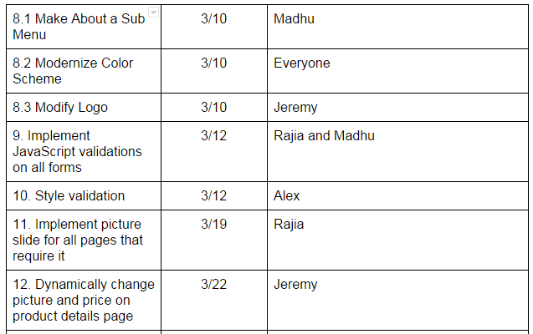
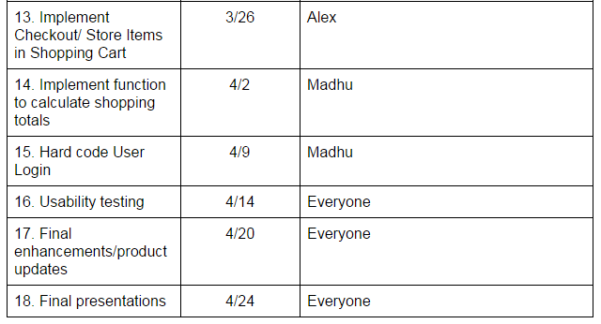
Not Yet Implemented Features & Delivery Schedule

Slide 7
Final Look & Feel, Current Status & Conclusion
Currently we have met the goals to date and are on track to complete the remaining ones :)
We hope that the final version of our website will be appealing to users and will encourage them to buy a Flaire.

